Slide 1
Performance

Slide 2
Performance – Deployment

Slide 3
Categories of performance
Requirement | Challenges
High Throughput | Unable to processing high-volume, high-velocity data Impact: Increased cost ($, time) per inference
Low Response Time | Applications don’t deliver real-time results Impact: Negatively affects user experience (voice recognition, personalized recommendations, real-time object detection)
Power and Memory Efficiency | Inefficient applications Impact: Increased cost (running and cooling), makes deployment infeasible
Deployment-Grade Solution | Research frameworks not designed for production Impact: Framework overhead and dependencies increases time to solution and affects productivity

Slide 4
Levers
Batch size
Reduce for less latency
Increase for more throughput
Tools
The right deployment platform
TensorRT

Slide 5
NVIDIA TensorRT

Slide 6


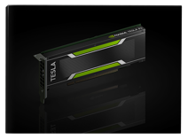


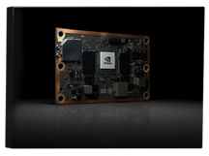


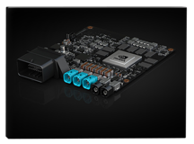







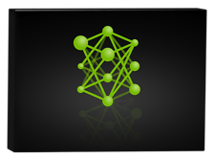


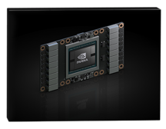


NVIDIA Tensorrt
Programmable Inference Accelerator
frameworks
Gpu platforms
TESLA P4
TensorRT
JETSON TX2
Optimizer
Runtime
DRIVE PX 2
NVIDIA DLA
TESLA V100
developer.nvidia.com/tensorrt

Slide 7
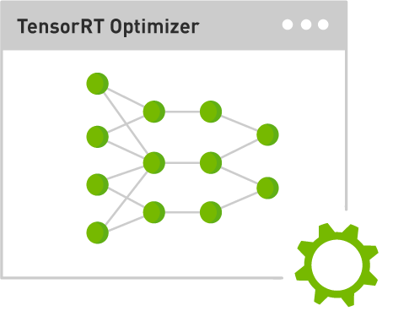

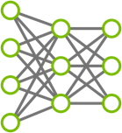

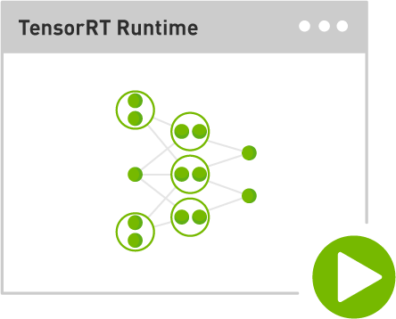
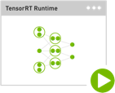



TensorRT deployment WORKFLOW
Step 1: Optimize trained model
Import
Model
Serialize
Engine
Plan 1
Plan 2
Plan 3
Trained Neural Network
TensorRT Optimizer
Optimized Plans
Step 2: Deploy optimized plans with runtime
Plan 1
De-serialize
Engine
Deploy
Runtime
Plan 2
Data center
Plan 3
Optimized Plans
TensorRT Runtime Engine
Automotive
Embedded
Notes:
The Inference Optimization Engine runs a a suite of performance benchmarks on the target platform identifying the best strategies for deployment on that platform, which are then serialized to an Inference Strategy file.
The Inference Execution Engine loads the Inference Strategy file and executes it in a highly optimized runtime, delivering highest performance possible for the specific DNN.

Slide 8
TensorRT optimizations

Slide 9
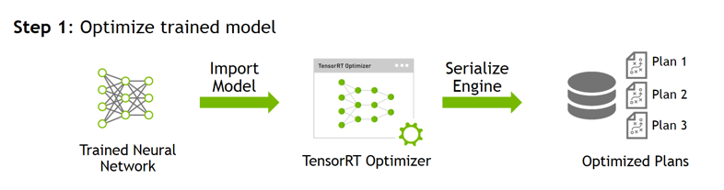
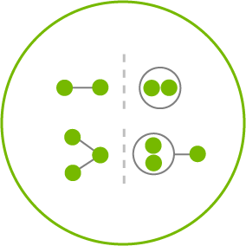
Layer & Tensor Fusion
Un-Optimized Network
TensorRT Optimized Network
next input
next input
concat
relu
relu
relu
relu
1x1 CBR
bias
bias
bias
3x3 CBR
5x5 CBR
bias
1x1 conv.
3x3 conv.
5x5 conv.
1x1 conv.
relu
relu
max pool
1x1 CBR
max pool
bias
bias
1x1 conv.
1x1 conv.
input
input
concat

Slide 10
Layer & Tensor Fusion
Un-Optimized Network
TensorRT Optimized Network
Vertical Fusion
Horizonal Fusion
Layer Elimination
next input
next input
concat
relu
relu
relu
relu
1x1 CBR
bias
bias
bias
3x3 CBR
5x5 CBR
bias
Network | Layers before | Layers after
VGG19 | 43 | 27
Inception V3 | 309 | 113
ResNet-152 | 670 | 159
1x1 conv.
3x3 conv.
5x5 conv.
1x1 conv.
relu
relu
max pool
1x1 CBR
max pool
bias
bias
1x1 conv.
1x1 conv.
input
input
concat

Slide 11
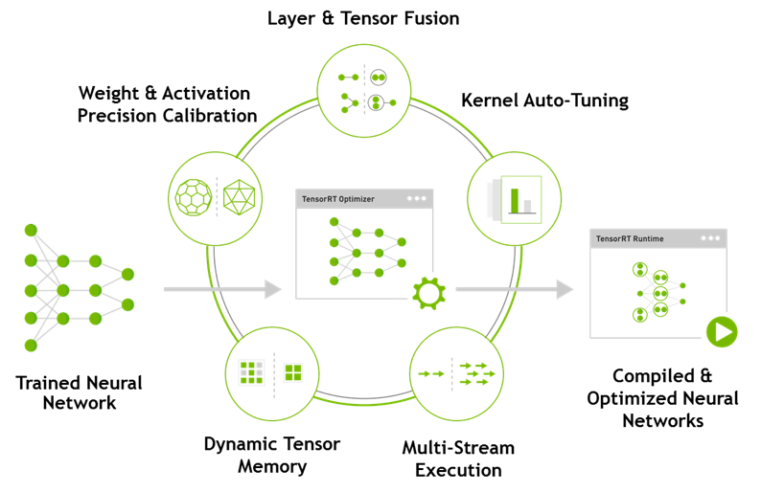
Tensorrt Key Info
Generate optimized, deployment-ready runtime engines for low latency inference
Import models trained from Caffe or TensorFlow, or use Network Definition API
Deploy in FP32 or reduced precision INT8, FP16 for higher throughput
Optimize frequently used layers and integrate user defined custom layers

Slide 12
Performance – Training

Slide 13
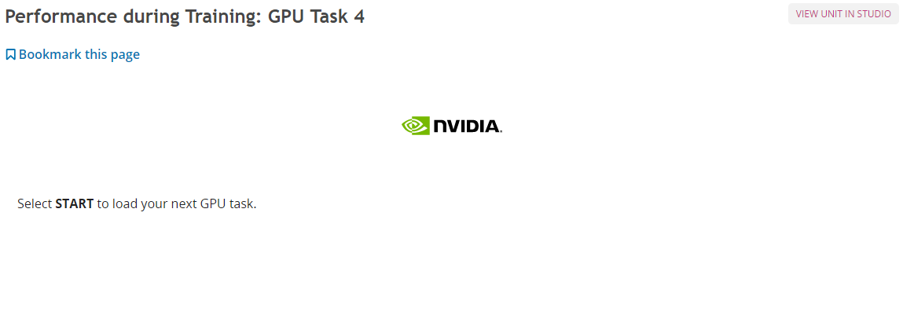
Next Page

Slide 14
Learning Principle
Dataset
Output/Prediction
Target Output
x₁
x₂
…..
x_{n}
Error:
-
= 5
Notes:
Note: This is presented twice intentionally. We reintroduce this learning principle again because we will use it to teach “learning rate” 3 slides later.

Slide 15
Learning Principle
Output/Prediction
Target Output
x₁
x₂
…..
x_{n}
Error:
-
= 15

Slide 16
Learning Principle
Output/Prediction
Target Output
x₁
x₂
…..
x_{n}
Error:
-
= 2.5

Slide 17
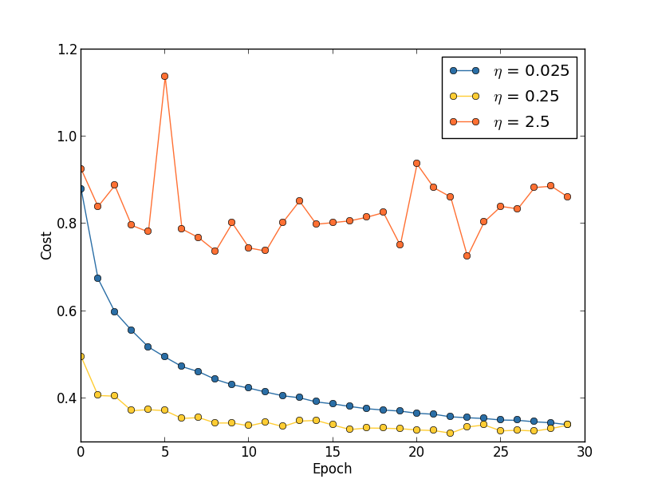
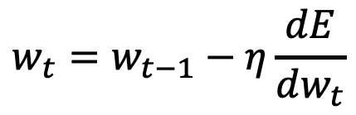
One HyperParameter: Learning Rate
$$w_{t}=w_{t−1}−η\frac{dE}{dw_{t}}$$
Notes:
This shows a simple representation of gradient descent, where, during backpropagation, each weight is changed by a multiplier (the learning rate) * the derivative of the error with respect to each weight.

Slide 18
TECHNIQUES TO IMPROVE MODEL
More training – GPU Time
More/better data – Data Science
Searching Hyperparameters – Learning Design
Modify the network – Network Architecture – Next Section
Notes:
. Before we introduced these images, we had a model that was correctly predicting white digits on a black background over 95% of the time.
We next introduce the challenge of classifying images that are DIFFERENT than our training images.

Slide 19

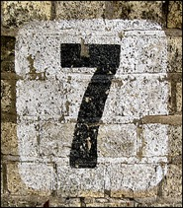
Performance Improvement
Ideas?
Increase accuracy and confidence with similar data
Generalize performance to more diverse data
Notes:
Present this case study which is with a different dataset, MNIST, which shows the type of work you *could* do with data (augmentation) to influence results.
The main intent here is to inform the audience that despite popular opinion, DL performance is not only controlled by “algorithms”.

Slide 20







More data
Full dataset ( 10 epochs )
99% of accuracy achieved
No improvements in recognizing real-world images
 | SMALL DATASET | FULL DATASET
 | 1 : 99.90 % | 0 : 93.11 %
 | 2 : 69.03 % | 2 : 87.23 %
 | 8 : 71.37 % | 8 : 71.60 %
 | 8 : 85.07 % | 8 : 79.72 %
 | 0 : 99.00 % | 0 : 95.82 %
 | 8 : 99.69 % | 8 : 100.0 %
 | 8 : 54.75 % | 2 : 70.57 %
Notes:
By adding MORE data, we don’t do much better. Our dataset is very homogeneous, adding MORE might make our model more confident, but not necessarily better. Also, data collection is hard, you’re likely using all of the data that you’ve collected.

Slide 21
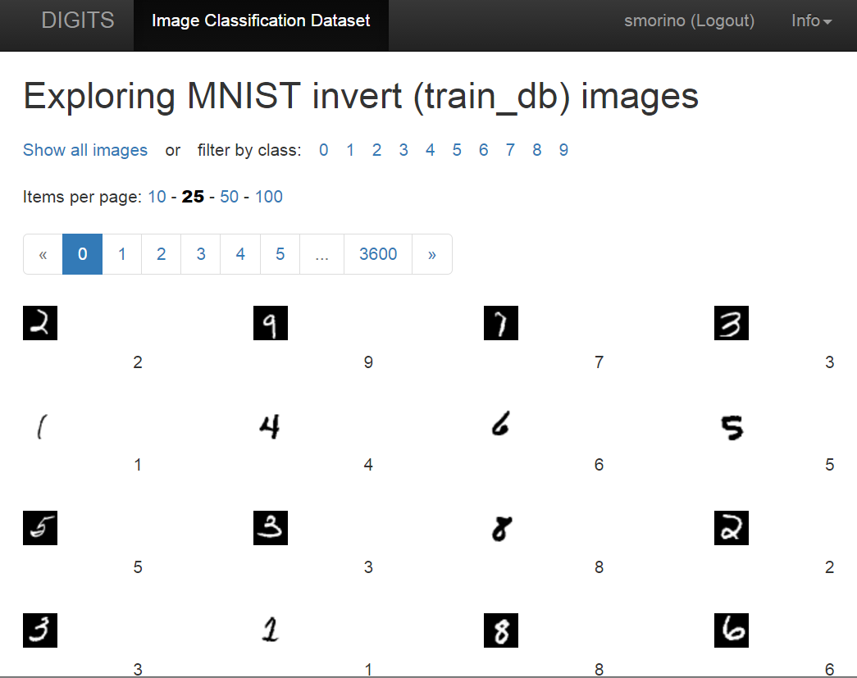
DATA AUGMENTATION
Adding Inverted Images
Pixel(Inverted) = 255 – Pixel(original)
White letter with black background
Black letter with white background
Training Images: /home/ubuntu/data/train_invert
Test Image: /home/ubuntu/data/test_invert
Dataset Name: MNIST invert
Notes:
Augmenting data is the practice of changing characteristics of the data to create a more diverse dataset. This can often be done with one line of code, not hunting for more examples.
In this case we inverted the background color with the images, but we could have rotated, flipped, etc. The important thing to keep in mind is to augment your data in ways you’d find it in the real world and that don’t confuse your model. For example, flipping a 6 180 degrees would likely decrease your ability to predict 9s.

Slide 22
DATA AUGMENTATION
Adding inverted images ( 10 epochs )
 | SMALL DATASET | FULL DATASET | +INVERTED
 | 1 : 99.90 % | 0 : 93.11 % | 1 : 90.84 %
 | 2 : 69.03 % | 2 : 87.23 % | 2 : 89.44 %
 | 8 : 71.37 % | 8 : 71.60 % | 3 : 100.0 %
 | 8 : 85.07 % | 8 : 79.72 % | 4 : 100.0 %
 | 0 : 99.00 % | 0 : 95.82 % | 7 : 82.84 %
 | 8 : 99.69 % | 8 : 100.0 % | 8 : 100.0 %
 | 8 : 54.75 % | 2 : 70.57 % | 2 : 96.27 %
Notes:
Incredibly, by adding black and white images to white and black one’s we’re able to more accurately classify other colors and shapes!
Essentially, we’ve forced our model to expand it’s definition of what makes each digit unique. A human analogy to this is when international travel opens your eyes to the fact that there are more than one way to travel, or eat, instead of just the specific difference that you observe.

